Slide 1
Summary

Slide 2
Summary
Implementation
Theory

Slide 3
Implementation

Slide 4


1. Language
Python
model building
R
Exploration and data analysis
Statistical analysis

Slide 5


2. Notebook

Slide 6


3. Libraries
scikit learn
Keras

Slide 7
Theory

Slide 8
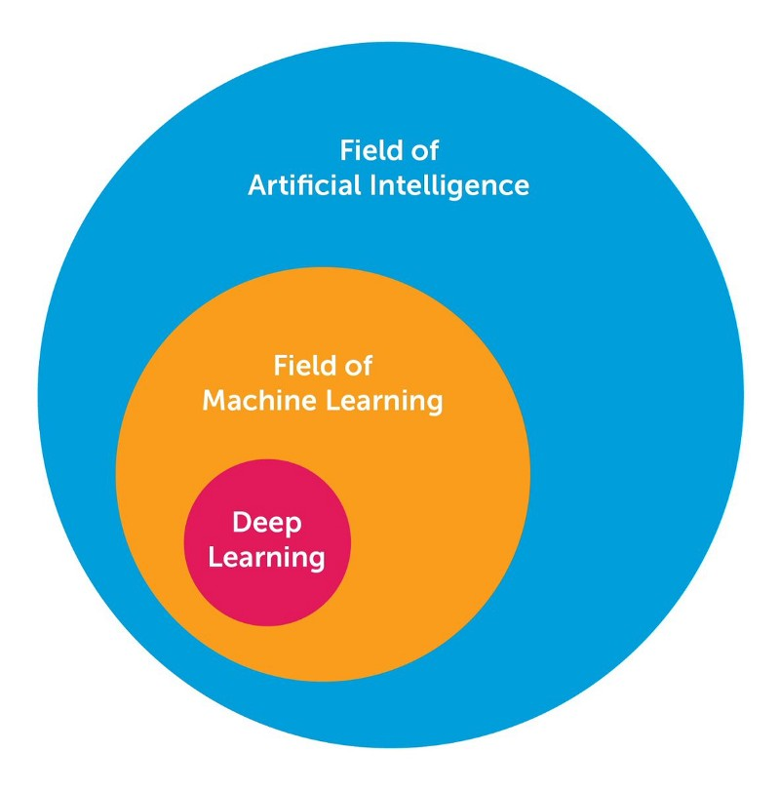

$$AI←ML←DL$$

Slide 9
Типы машинного обучения
Machine Learning
Supervised learning
Unsupervised learning
Reinforcement learning

Slide 10
Типы задач
Supervised learning
Unsupervised learning
Regression problem
Classification problem
Clustering problem
Dimension reduction

Slide 11
Regression problem
«Classical»
algorithms
Neural networks

Slide 12
«Classical»
algorithms
Regression models
Autoregressive models
Decision Tree models
Linear regression
(Lasso regression, Ridge regression)
Arima
(Sarima, Regarima)
Random forest

Slide 13
Neural networks
Recurrent neural network
LSTM

Slide 14
Classification problem
«Classical»
algorithms
Neural networks

Slide 15
«Classical»
algorithms
Logistic regression

Slide 16
Neural networks
Capsule neural network

Slide 17
Machine learning
Unsupervised learning
Supervised learning
Reinforcement learning
Clustering problem
Dimension reduction
Regression problem
Classification problem
«Classical»
algorithms
Neural networks
«Classical»
algorithms
Neural networks
Regression models
Autoregressive models
Decision Tree models
LSTM neural network
Logistic regression
Capsule neural network
Linear regression
(Lasso regression, Ridge regression)
Arima
(Sarima,Regarima)
Random forest

Slide 18
Полезные материалы
Курсы:
https://mlcourse.ai/
https://ru.coursera.org/learn/ekonometrika
https://ru.coursera.org/learn/supervised-learning
https://ru.coursera.org/learn/data-analysis-applications
Книги:
Саймон Хайкин: Нейронные сети. Полный курс
Книга «Глубокое обучение. Погружение в мир нейронных сетей»
Бенджио, Гудфеллоу, Курвилль: Глубокое обучение

